Slide 1

Phishing Attacks Detection using Machine Learning and Deep Learning Models
DEPARTMENT OF INFORMATION TECHNOLOGY
Batch No – 11
DAMODARRAM K 212219220005
NITISH KUMAR R 212219220036
GOPI G 212219220009
GUIDED BY:
Dr. G NALINI PRIYA
Prof.
DEPT OF IT

Slide 2
AGENDA
INTRODUCTION
OBJECTIVE
SCOPE
LITERATURE SURVEY (in Tabular column)
EXISTING SYSTEM & DRAW BACKS
PROBLEM DEFINITION
PROPOSED SYSTEM
SYSTEM ARCHITECTURE
MODULES (with Description and Flowchart/Module Mapping)
OUTPUTS (Screenshots and Results)
SWOT Analysis
CONCLUSION
FUTURE ENHANCEMENT
REFERENCES

Slide 3
INTRODUCTION
There are a lot of algorithms and a wide variety of data types for phishing detection in the academic literature and commercial products. A phishing URL and the corresponding page have several features which can be differentiated from a malicious URL. For example; an attacker can register long and confusing domain to hide the actual domain name (Cyber squatting, Typo squatted) Features collected from academic studies for the phishing domain detection with machine learning techniques are grouped as given below.
URL-Based Features
Domain-Based Features
Page-Based Features
Content-Based Features
Mainly there is use of Natural Language Processing (NLP) and other machine learning techniques. Moreover much use more technical features and process them using machine learning algorithms has been imposed.

Slide 4
OBJECTIVE
Phishing sites which expects to take the victims confidential data by diverting them to surf a fake website page that resembles a honest to goodness one is another type of criminal acts through the internet and its one of the especially concerns toward numerous areas including e-managing an account and retailing. Phishing site detection is truly an unpredictable and element issue including numerous components and criteria that are not stable. On account of the last and in addition ambiguities in arranging sites because of the intelligent procedures programmers are utilizing, some keen proactive strategies can be helpful and powerful tools can be utilized, for example, fuzzy, neural system and data mining methods can be a successful mechanism in distinguishing phishing sites. We applied Random Forest (RF), one of the different types of machine learning based algorithms used for detection of Phishing websites. Finally we measured and compared the performance of the classifier in terms of accuracy.

Slide 5
SCOPE
The system should be useful in many e-commercial websites for maintaining the security and reliability of customers and people online
The system should be useful in preventing online frauds leading to leakage of important and private user data
The scope of using Machine Language over other Traditional Detecting Methods

Slide 6
APPLICATION
Hardware Requirements
System : Intel Pentium IV 2.80 GHz.
Monitor : LED.
Mouse : Logitech.
Ram : 4.00 GB or above 4.00 GB
Hard Disk : 250 GB
Software Requirements
Operating system : Windows 7, Ubuntu
Language : Python

Slide 7
LITERATURE SURVEY
S.NO | TITLE | AUHTOR/YEAR | DESCRIPTION | TECHNIQUE
1 | Detecting Phishing Websites via Aggregation Analysis of Page Layouts | JianMao ,JingdongBian ,WenqianTian ,ShishiZhu ,TaoWei ,AiliLi ,ZhenkaiLiang/ 2018 | In this paper, we aim to improve phishing detection techniques using machine learning techniques. In particular, we propose a learning-based aggregation analysis mechanism to decide page layout similarity, which is used to detect phishing pages. Our experiment results shows that our approach is accurate and effective in detecting phishing pages. | Support Vector Machine (SVM), DecisionTree (DT)

Slide 8
LITERATURE SURVEY
S.NO | TITLE | AUHTOR/YEAR | DESCRIPTION | TECHNIQUE
2 | Detection of Phishing Websites using Machine Learning | Atharva Deshpande , Omkar Pedamkar , Nachiket Chaudhary , Dr. Swapna Borde/ 2021 | This paper surveys the features used for detection and detection techniques using machine learning. Phishing is popular among attackers, since it is easier to trick someone into clicking a malicious link which seems legitimate than trying to break through a computers defense systems. The malicious links within the body of the message are designed to make it appear that they go to the spoofed organization using that organizations logos and other legitimate contents. | Random forest algorithm and Decision tree

Slide 9
LITERATURE SURVEY
S.NO | TITLE | AUHTOR/YEAR | DESCRIPTION | TECHNIQUE
3 | A Novel Machine Learning Approach to Detect Phishing Websites | Ishant Tyagi; Jatin Shad; Shubham Sharma; Siddharth Gaur; Gagandeep Kaur/ 2018 | This paper is focused on various Machine Learning algorithms aimed at predicting whether a website is phishing or legitimate. Machine learning solutions are able to detect zero hour phishing attacks and they are better at handling new types of phishing attacks, so they are preferred. In our implementation, we managed an accuracy of 98.4% in prediction a website to be phishing or legitimate. | Decision Tree, Random Forest, Gradient Boosting (GBM), Generalized Linear Model and K-Nearest-Neighbors (KNN).

Slide 10
LITERATURE SURVEY
S.NO | TITLE | AUHTOR/YEAR | DESCRIPTION | TECHNIQUE
4 | Phishing Detection Using Machine Learning Techniques | Vahid Shahrivari, Mohammad Mahdi Darabi, Mohammad Izadi/ 2020 | One of the most successful methods for detecting these malicious activities is Machine Learning. This is because most Phishing attacks have some common characteristics which can be identified by machine learning methods. In this paper, we compared the results of multiple machine learning methods for predicting phishing websites. | Logistic Regression, Decision Tree, Random Forest, Ada-Boost, Support Vector Machine, KNN, Artificial Neural Networks, Gradient Boosting, and XGBoost.

Slide 11
LITERATURE SURVEY
S.NO | TITLE | AUHTOR/YEAR | DESCRIPTION | TECHNIQUE
5 | Development of anti-phishing browser based on random forest and rule of extraction framework | Mohith Gowda HR, Adithya MV, Gunesh Prasad S & Vinay S/ 2020 | In this paper, we propose a novel technique to identify phishing websites effortlessly on the client side by proposing a novel browser architecture. In this system, we use the rule of extraction framework to extract the properties or features of a website using the URL only. This list consists of 30 different properties of a URL, which will later be used by the Ada boost Classification machine learning model to detect the authenticity of the website. | Random Forest Classification machine learning model

Slide 12
EXISTING SYSTEM
There are countless domains where phishing attack can occur like online payment sector, webmail, and financial institution, file hosting or cloud storage and many others. The webmail and online payment sector was embattled by phishing more than in any other industry sector. Phishing can be done through email phishing scams and spear phishing hence user should be aware of the consequences and should not give their 100 percent trust on common security application. Machine Learning is one of the efficient techniques to detect phishing as it removes drawback of existing approach.

Slide 13
PROPOSED SYSTEM
Trying to gather personal information through deceptive ways is becoming more common nowadays. In order to assist the user to be aware of the access to such websites, the implemented system notifies the user through email and also pop-up, when trying to access a phishing site. This paper proposes an approach of phishing detection system to detect blacklisted URL also known as phishing websites, so that individual can be alerted while browsing or accessing a particular website. Therefore, it can be utilized for identification and authentication and become a legitimate tool to prevent an individual from getting tricked.

Slide 14
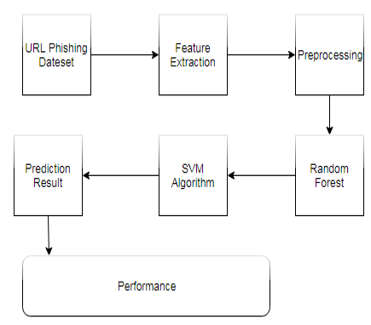
SYSTEM ARCHITECTURE

Slide 15
ALGORITHM
Logistic Regression
Support Vector Machine
Random Forest Classification

Slide 16
MODULES
Detection Technique
Phishing Websites Features
Data Set

Slide 17
DETECTION TECHNIQUE
Detection of phishing websites has received a lot of attention recently due to their impact on users’ security. Therefore, many techniques have been developed to detect phishing websites varying from communication-oriented techniques, such as authentication protocols, blacklisting, and white-listing, to content-based filtering techniques. The blacklisting and white-listing techniques have not proven though to be sufficiently efficient when used in different domains, and thus they are not commonly used. Meanwhile, the content-based phishing filters have been widely used and have proven to be of high efficiency. In light of this, researches have focused on content-based mechanism and on developing machine learning and data mining techniques based on the header and body of emails.

Slide 18
PHISHING WEBSITES FEATURES
One of the challenges faced by us is the unavailability of reliable training datasets. In fact, this challenge faces any researcher in the field. However, although plenty of articles about predicting phishing websites using data mining techniques have been disseminated these days, no reliable training dataset has been published publically, maybe because there is no agreement in literature on the definitive features that characterize phishing websites, hence it is difficult to shape a dataset that covers all possible features.
In this article, we shed light on the important features that have proved to be sound and effective in predicting phishing websites. In addition, we proposed some new features, experimentally assign new rules to some well-known features and update some other features.

Slide 19
DATASET
The dataset is collected from the kaggle website which is an open source. It consists of 16 features and more than 1000 records.

Slide 20
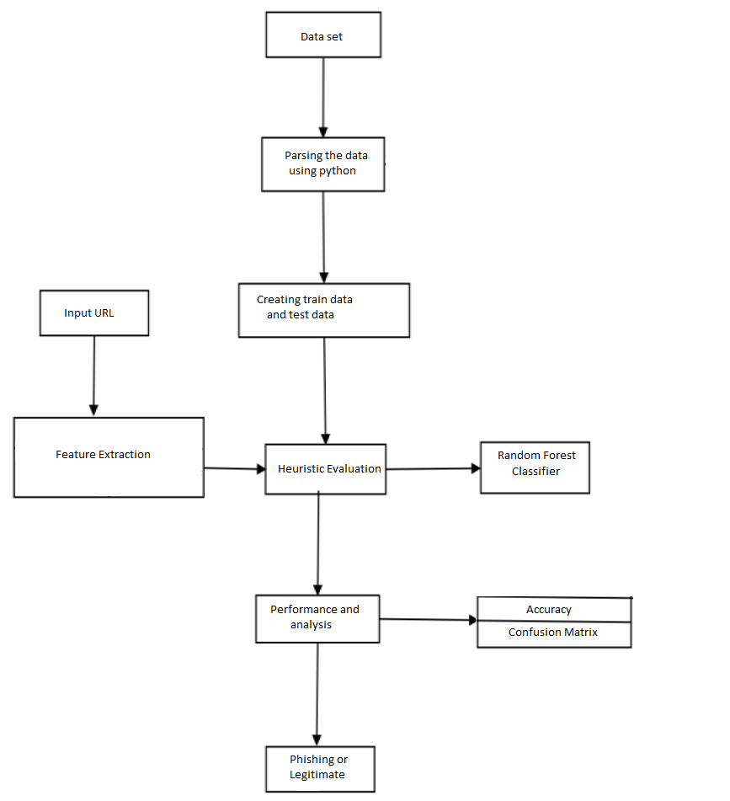
DATAFLOW DIAGRAM

Slide 21
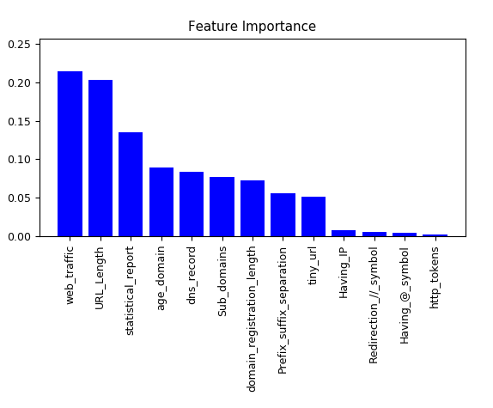

Slide 22
OUTPUT

Slide 23
CONCLUSION
Phishing is a cyber crime procedure utilizing both social building and specialized deception to take individual sensitive data. Besides, Phishing is considered as another extensive type of fraud. Experimentations against recent dependable phishing data sets utilizing different classification algorithm have been performed which received different learning methods. The base of the experiments is accuracy measure.
The aim of this research work is to predict whether a given URL is phishing website or not. It turns out in the given experiment that Random forest based classifiers are the best classifier with great classification accuracy of 95.47% for the given dataset of phishing site. As a future work we might use this model to other Phishing dataset with larger size then now and then testing the performance of those classification algorithm’s in terms of classification accuracy.

Slide 24
FUTURE ENHANCEMENT
Future work will aim to develop a system that can learn by itself about new types of phishing attacks by adding a more enhanced feature to the detection process. The scope of this approach not only helps in adding more enhanced features but also updating the existing features to improve its importance level to make detection more efficient and reduce the false positive rate to a large extent.

Slide 25
REFERENCES
[1] Erzhou Zhu,Yuyang Chen,Chengcheng Ye,Xuejun Li,Feng Liu, “OFSNN:An Effective Phishing Websites Detection Model Based on Optimal Feature Selection and Neural Network,” IEEE Access(Volume:7), pp. 73271-73284, June 2019.
[2] Youness Mourtaji,Mohammed Bouhorma,Alghazzawi, “Perception of a new framework for detecting phishing web pages,” Mediterranean Symposium on Smart City Application Article No. 11, Tangier, Morocco, October 2017.
[3] Akihito Nakamura,Fuma Dobashi, “Proactive Phishing Sites Detection,” WI '19 IEEE/WIC/ACM International Conference on Web Intelligence), pp. 443-448, October 2019.
[4] Ebubekir Büber, ' Phishing URL Detection with M', [Online]. Available: https://towardsdatascience.com/phishing-domaindetection-with-ml-5be9c99293e5 [Accessed: 10- November- 2019].

Slide 26
REFERENCES
[5] scikit-learn, , Machine Learning in Python, [Online]. Available: https://scikit-learn.org/stable/ [Accessed: 10- November- 2019].
[6] Mohammed Nazim Feroz,Susan Mengel, “Phishing URL Detection Using URL Ranking,” IEEE International Congress on Big Data, July 2015.
[7] Mahdieh Zabihimayvan, Derek Doran, “Fuzzy Rough Set Feature Selection to Enhance Phishing Attack Detection,” International Conference on Fuzzy Systems (FUZZ-IEEE), New Orleans, LA, USA, June 2019.

